Slide 1
NDC Receipt Collector
IATA NDC Hackathon: Challenge #5

Slide 2
The Problem

Slide 3
SBTs can’t be the source of truth for Air Travel bookings

Slide 4
UnbundlEd Airfares +
more ancillaries +
more reconciliation =
full cost of Air Travel

Slide 5
The Solution

Slide 6
The
NDC
RECEIPT
COLLECTOR
A
Solution

Slide 7
How it Works

Slide 8
Air Travel Reconciliation Today
Points of Purchase
Data Aggregation
Analysis
SBT
Manual/Automatic Reconciliation
OTA
Travel
Cost Analysis
Airline.com
Open Booking:
Trip Link/Rocket Trip
AirlineApp
Doing Nothing
????
In Flight purchases

Slide 9
Air Travel Reconciliation ToMorrow
Points of Purchase
Standardized reports for downstream systems
NDC XML
SBT
NDC
Receipt
Collector
OTA
Travel
Cost Analysis
Airline.com
AirlineApp
In Flight purchases
Your App

Slide 10
1. Merchant integration
2. Company Policy Configuration
3. Traveler Signup and purchases

Slide 11
Merchant Integration Examples
SBT Server
(AN NDC Client)
NDC
Receipt
Collector
Travel
Cost Analysis
Node.js Library
airline
Mobile App
iOS/Android SDK

Slide 12
NDCRC System Overview
Company
Merchant
[Services]
[Approved Merchant Services]
Transaction
[Reports]
Service
[Users]
User

Slide 13

Pricing

Slide 14
Who Wins?

Slide 15
1. Travel Managers
- Policy information at the service level is pushed to the point of purchase for all booking channels
- categorization of all Air travel costs, no matter the payment method, with no human Error

Slide 16
2. Business Travelers
- A Simplified Corporate Air travel experience
- #nomorereceipts

Slide 17
3. Travel Merchants
- A clear path to start adopting the NDC standard without the complexity of building fully compliant NDC systems*

Slide 18
*This can be achieved by writing a simple wrapper to translate internal transaction records (receipts) to the NDC Standard format required by NDCRC

Slide 19
Built this weekend

Slide 20
Data Pipeline from Merchants
Admin Web App
NDCRC Libraries/SDK’s
Kibana
(Visualizations)
Segment Client Libraries
NDCRC Server
Elastic Search
(DataBase)

Slide 21
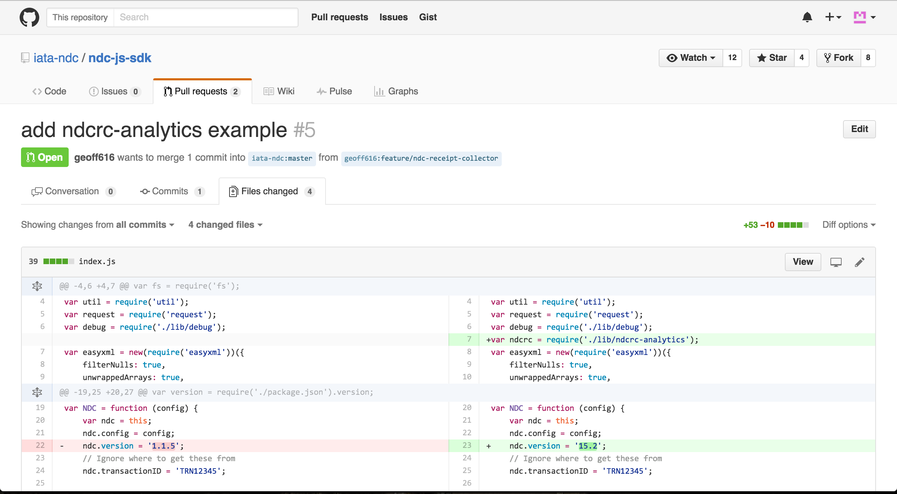
NDC-js-sdk Integration

Slide 22
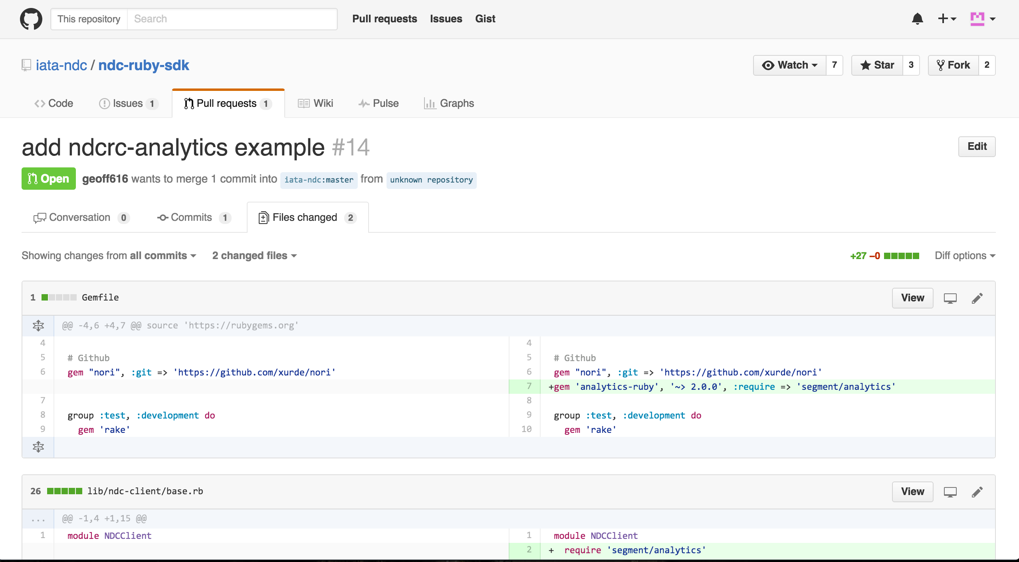
NDC-Ruby-sdk Integration

Slide 23
Live Links
Demo Site
Admin Section
GitHub Repo

Slide 24
NDCRC Advantages
Direct Integration w/ Merchants
Simplified NDC Implementation
Push policy data to merchants

Slide 25
- Additional Admin functionality
- Pushing Travel policy to merchants
- Security + PCI compliance
to be Built

Slide 26


The Team
Present and sleepy
Did not participate in this stage; currently stuck in America*
Fullstack Engineer, Partner @ Data Joes
Measurement Consultant, Partner @ Data Joes
*Until we win plane tickets!

Slide 27
- Identify partnership opportunities with SBT’s and other Corporate Travel Purchase points
- Use the prize money to incubate NDCRC within Data Joes And Complete development of the platform
Next Steps

